Slide 1



HCN mapping of the Taurus Molecular Cloud
Harrison Bradley
With Dr. Yancy Shirley and Samantha Andrews
Credit: Adam Block

Slide 2
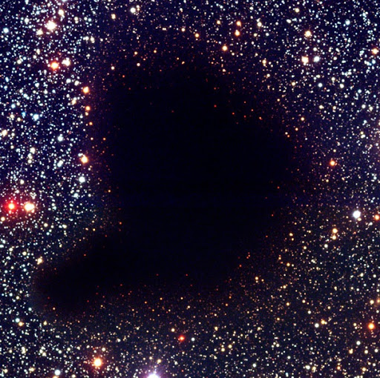
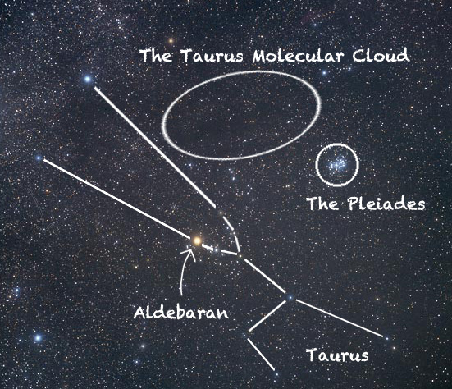

Taurus Molecular Cloud (TMC)
Closest star forming region – 430 ly (140 pc) with ~30,000 Solar Masses.
Only a few % of dust/gas forms into low mass stars!
Emission/absorption from dust grains gives no kinematic information.
  Need molecular lines.
Chemistry creates molecules that trace different densities.
  Low Density: Carbon Monoxide (CO)
  Intermediate/high Density: Hydrogen Cyanide (HCN)
We want to learn about the dynamics of gas/dust at these intermediate densities.
Credit: David Malin

Slide 3
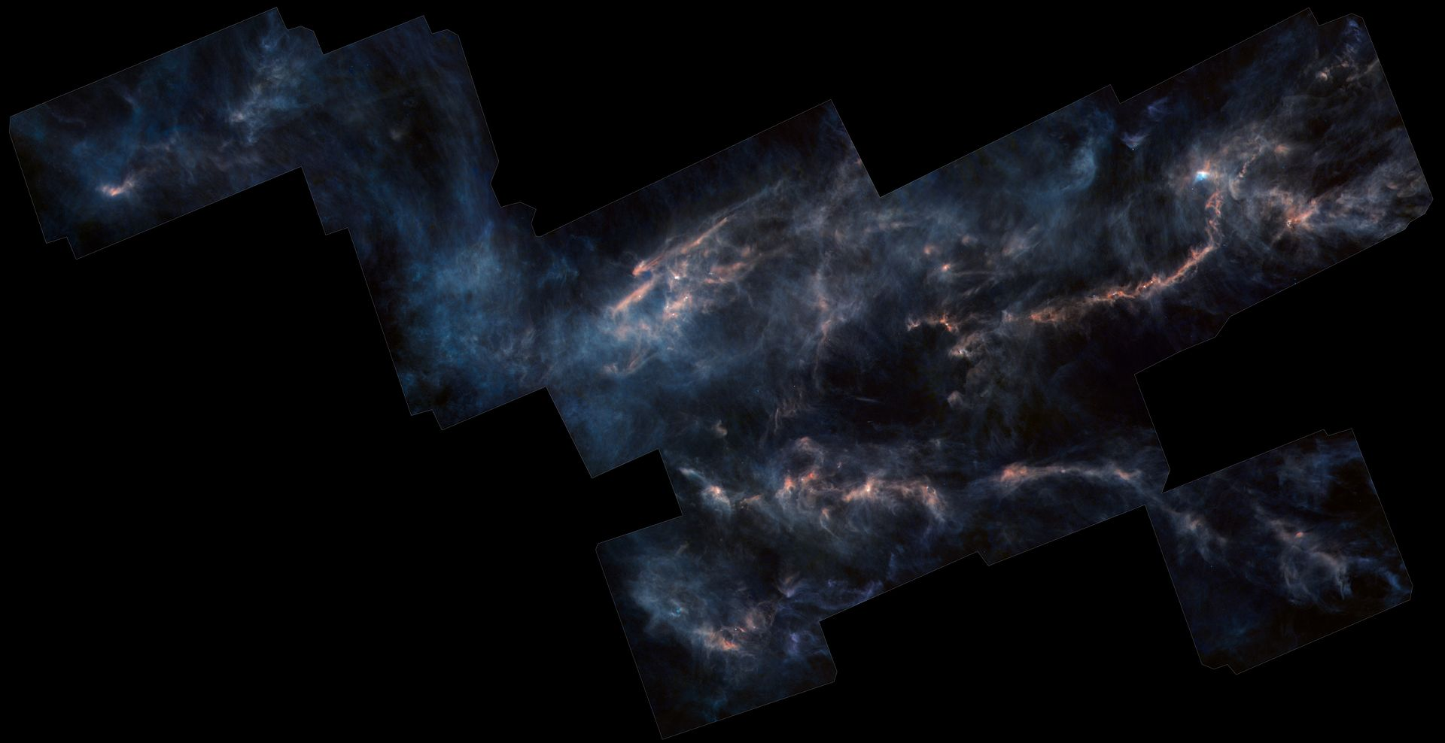
Taurus Molecular Cloud (TMC)
Closest star forming region – 430 ly (140 pc) with ~30,000 Solar Masses.
Only a few % of dust/gas forms into low mass stars!
Emission/absorption from dust grains gives no kinematic information.
  Need molecular lines.
Chemistry creates molecules that trace different densities.
  Low Density: Carbon Monoxide (CO)
  Intermediate/high Density: Hydrogen Cyanide (HCN)
We want to learn about the dynamics of gas/dust at these intermediate densities.
Thermal Dust Emission
Credit: ESA/Herschel/NASA/JPL-Caltech

Slide 4
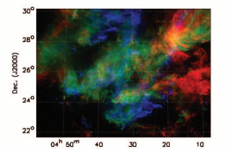
Taurus Molecular Cloud (TMC)
Closest star forming region – 430 ly (140 pc) with ~30,000 Solar Masses.
Only a few % of dust/gas forms into low mass stars!
Emission/absorption from dust grains gives no kinematic information.
  Need molecular lines.
Chemistry creates molecules that trace different densities.
  Low Density: Carbon Monoxide (CO)
  Intermediate/high Density: Hydrogen Cyanide (HCN)
We want to learn about the dynamics of gas/dust at these intermediate densities.
CO (1-0)
Thermal Dust Emission
Credit: Goldsmith et al. 2008

Slide 5
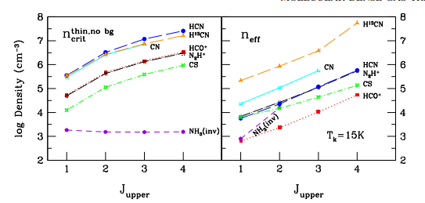
Taurus Molecular Cloud (TMC)
Closest star forming region – 430 ly (140 pc) with ~30,000 Solar Masses.
Only a few % of dust/gas forms into low mass stars!
Emission/absorption from dust grains gives no kinematic information.
  Need molecular lines.
Chemistry creates molecules that trace different densities.
  Low Density: Carbon Monoxide (CO)
  Intermediate/high Density: Hydrogen Cyanide (HCN)
We want to learn about the dynamics of gas/dust at these intermediate/high densities.
Thermal Dust Emission
Credit: Shirley 2015

Slide 6
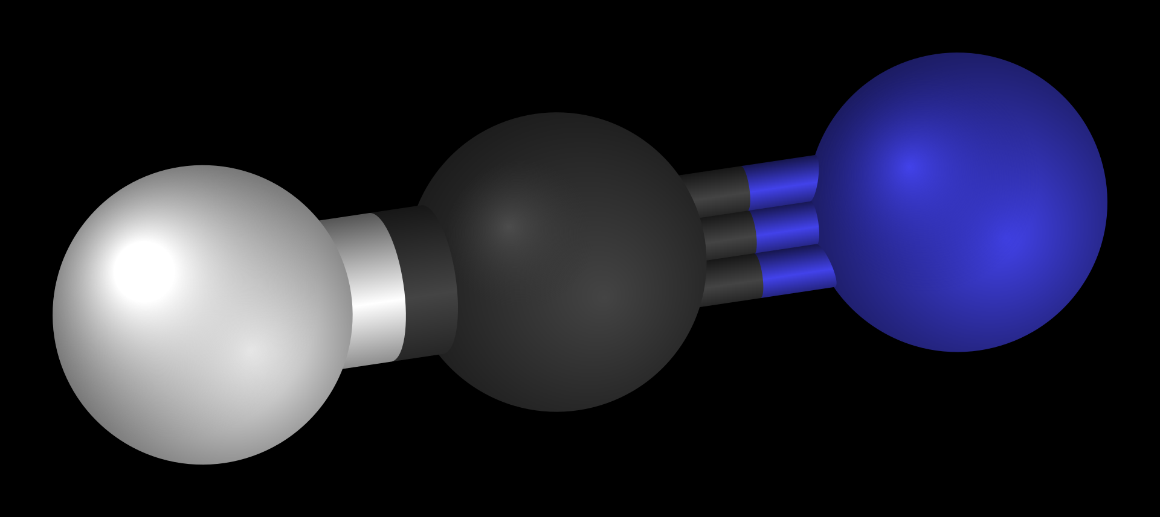
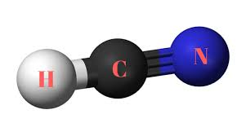
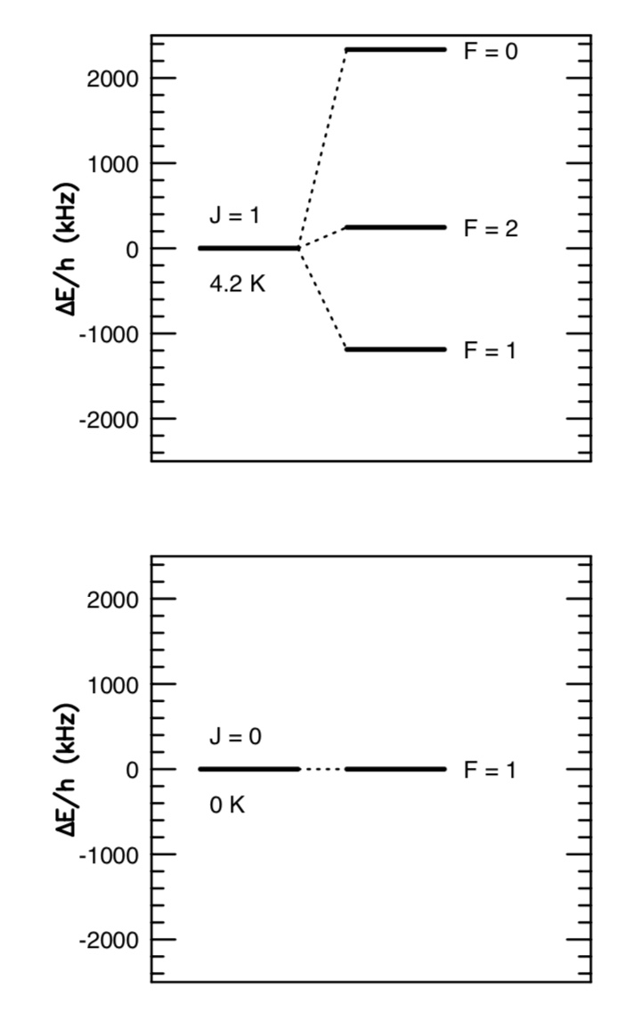
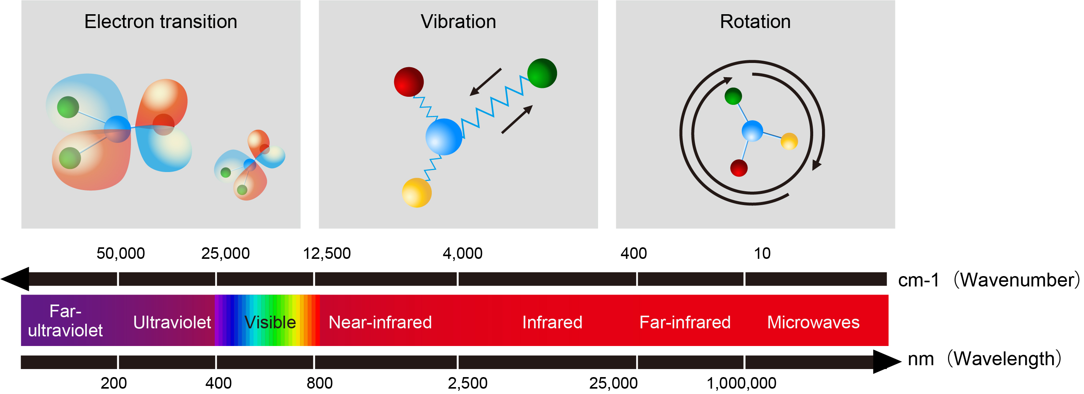
Spectroscopy
Energy associated with electron orbitals, molecular vibration, molecular rotation are quantized.
Energy can be emitted or absorbed in the form of photons between bound energy levels.
For cold, intermediate/high density gas: hydrogen cyanide (HCN) 1-0 rotational transition.
  3 hyperfine transitions probe different densities.
Credit: Yokogawa
Credit: Yancy

Slide 7
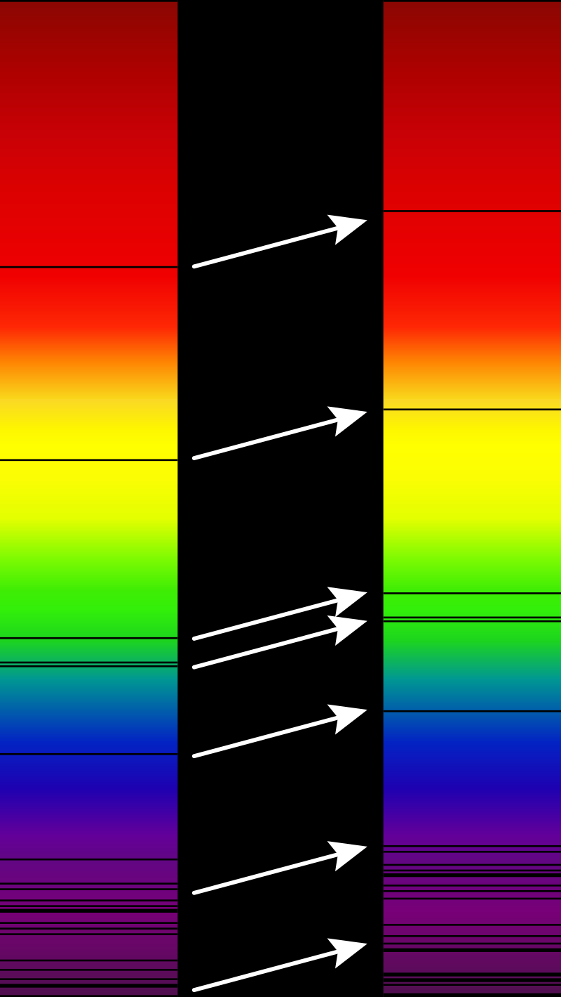
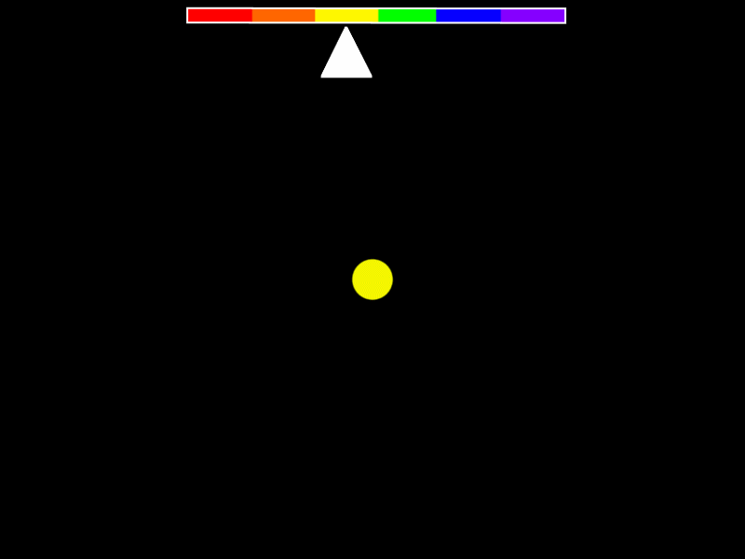
Doppler Effect
Credit: Georg Wiora
The frequency of light from a source changes with velocity towards or away from observer.
  Much like changing pitch of vehicles moving past.
  Redshift – away from observer
  Blueshift – towards observer
Use red/blueshift of lines to determine line-of-sight velocity of gas and dust.
Credit: Wikipedia

Slide 8
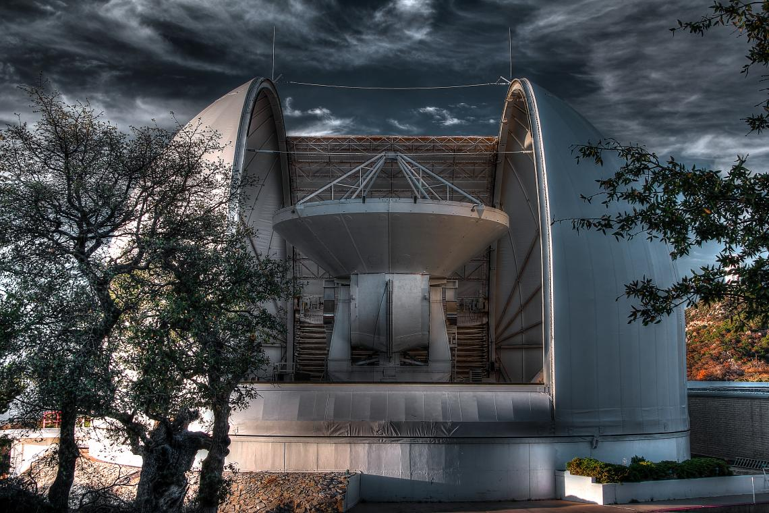
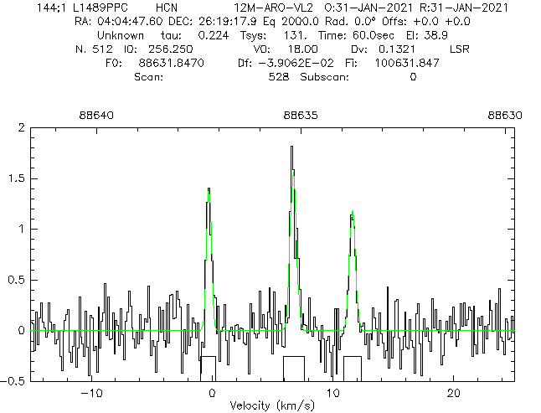
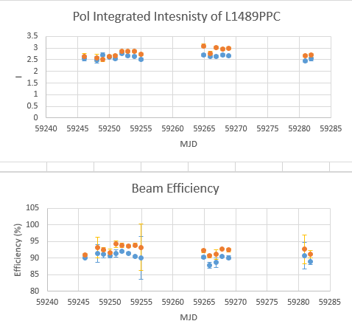
Calibration
In order to get reliable data, intensities must be adjusted for telescope beam efficiency, weather etc.
Conduct Point-Focus-Point on mars every ~2 maps.
Every night, compared intensity of known bright HCN source: L1489PPC

Slide 9
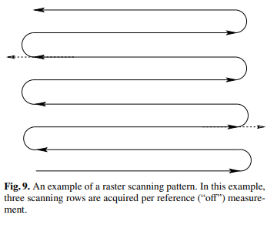
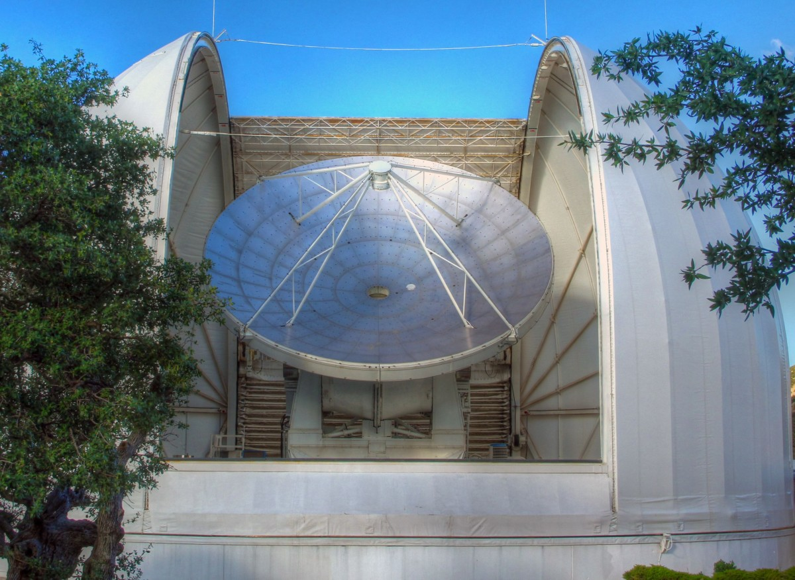
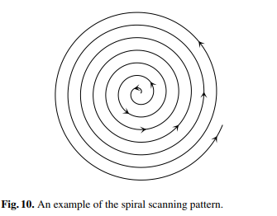
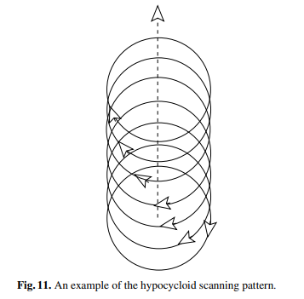
On-The-Fly mapping
Pixel size proportional to wavelength.
12 Meter telescope on Kitt Peak operates 1, 2, 3 mm bands.
  Uses a single pixel.
To create an image, we need to scan over then area, then average data.
Credit: Mangum et al. 2007
Credit: ARO

Slide 10
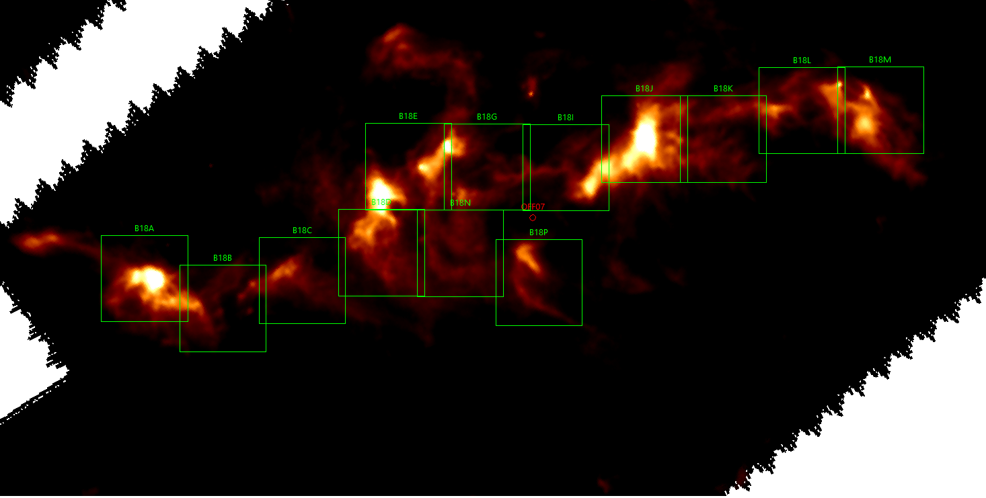
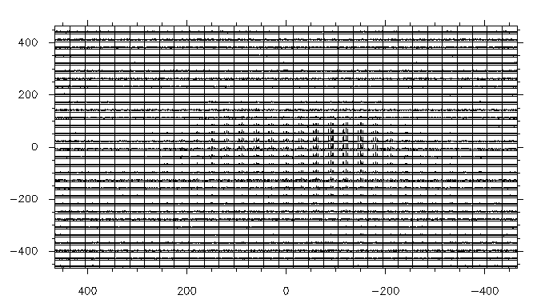
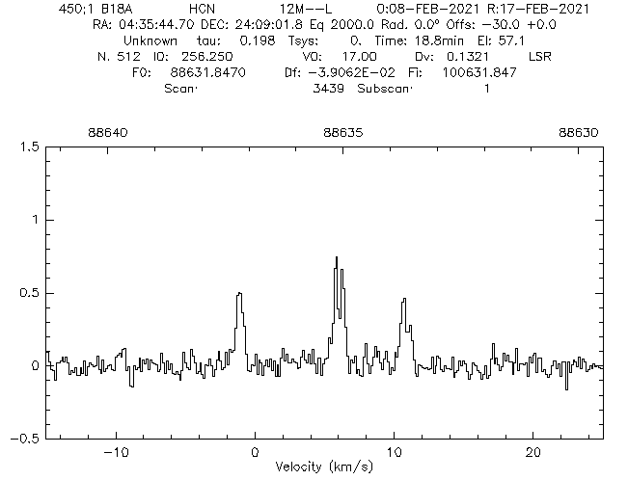
Observations
13 regions over the B18 filament of the TMC.
Regions mapped around ~88.6 GHz.
Combine with data taken by Dr. Yancy Shirley and Samantha Andrews of HC2 and B213.

Slide 11
Future
Better fit the data to account for asymmetry.
Map B18, B213, and HC2 regions according to velocity.
By mapping the velocity of the material, we can learn about the fluid dynamics of the filaments.
HC2
B213
B18
Credit: ESA/Herschel/NASA/JPL-Caltech

Slide 12
Acknowledgements
My greatest thanks to Dr. Yancy Shirley and Samantha Andrews for sharing their time and their wealth of experience which helped bring this project together. I’d also like to thank the Arizona Space Grant Consortium for funding this project and the Arizona Radio Observatory and Steward Observatory for allowing me to use the 12 Meter Telescope to make my observations. Finally, I’d like to thank the 12 Meter Telescope Operators Michael Begam, Clayton Kyle, and Kevin Bays for conducting the in-person observations while we have all been quarantined during the pandemic.

Slide 13
THANK YOU

